Slide 1
Agenda
Introduction
Organisational Background
Analysis
Vodafone strategy
Recommendations
5G Technology
Internet of Things
Artificial Intelligence
Conclusion
Reference

Slide 2
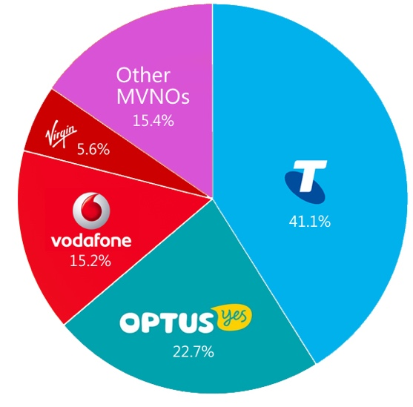
Introduction
One of the top leading telecommunication and Internet Services provider company
Third biggest market shared telecom company in Australia
Provide service include: Mobile, Broadband, IoT and Cloud Services.
Fig.1 Australian telecom market

Slide 3

Organisational Background
Vodafone was established in 1982
12th ranked mobile operator in the world
150 countries have Vodafone
1st Australian branch opened in 2009

Slide 4
Analysis
Strength
Global partnerships
Weakness
Threat
Cybersecurity risks
Opportunity
Cybersecurity service in market
Branches spread worldwide
Quantity of customers
Enormous user database
Revenue decreases
Less competition in market
Technology changes
Mobile termination reduces
Economic crisis
IoT technology provider service
IT services Cloud computing

Slide 5
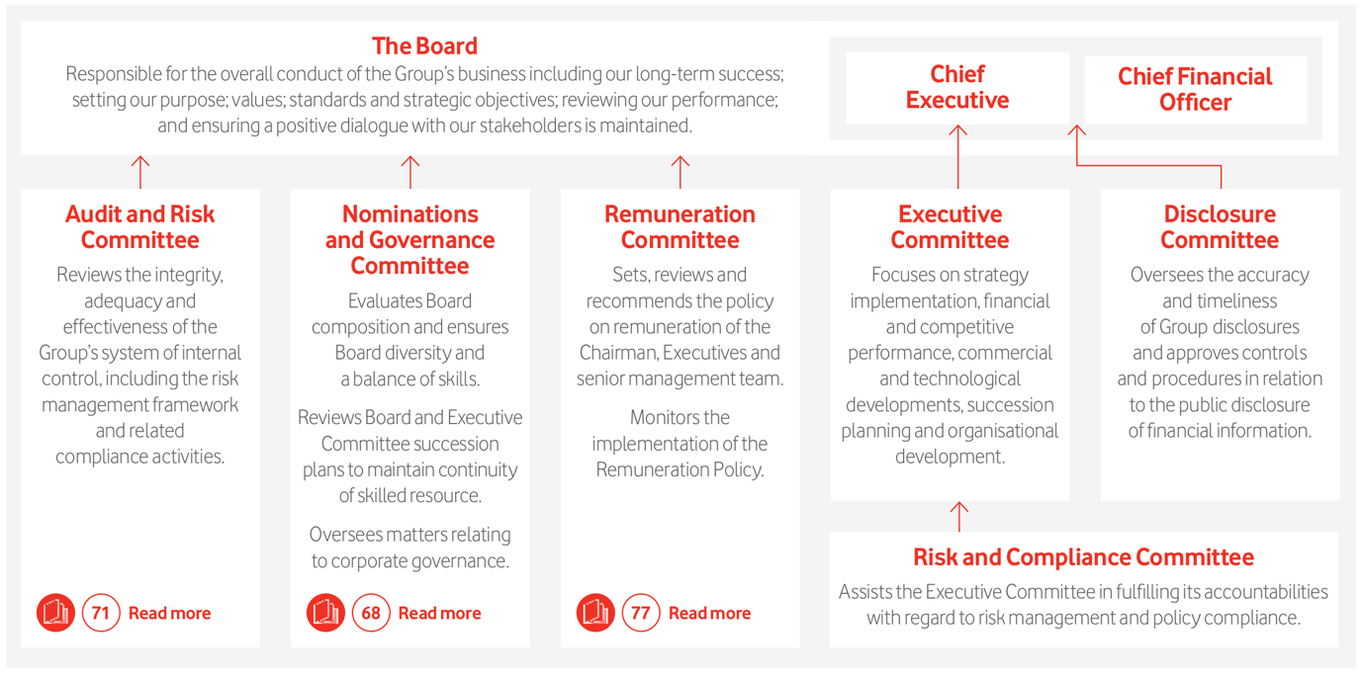
Vodafone management

Slide 6
Recommendation: 5G
Greater Bandwidth
Greater bandwidth will ensure faster download speed that will attract consumers
Massive Network Capacity
Reliable Connectivity
5G will provide reliable connectivity by ensuring greater bandwidth with a huge network of connected devices
Low cost-per-bit
The availability of faster uniform data rates and lower latency will lower the cost-per-bit,
5G will provide massive network support which means it can accommodate more consumers than before

Slide 7
Recommendation: 5G
Identify customer requirements
First, Customers and value chain needs to be identified in order to find a potential market. 5G has global potential market with customers all over the world
Set business model dimensions
Design and evaluate business model
Design and cross-match with the objectives which was set before. Evaluate the requirements and dimensions.
Finalize and deploy the business model
Finalize and implement business model to customers. Make 5G accessible to the consumers.
Based on the market and customer requirements a set of objectives should be determined as business dimensions. Such as selecting the 5G accessible zones based on the economy growth

